Slide 1
An Intercomparison of Water Flow and Gas Flow Laboratories using ISO 5167 Dp Devices
Jos van der Grinten NMi EuroLoop
Roy van Hartingsveldt NMi EuroLoop
Stefan Knöfel Siemens AG
Eberhard Gralla Siemens AG
Johann Kolar Seiko-Flowcontrol GmbH

Slide 2
Contents
Introduction
Dp Packages
Results
A and B tappings
C_{d} versus Re
Discussion
Conclusions and recommendations

Slide 3
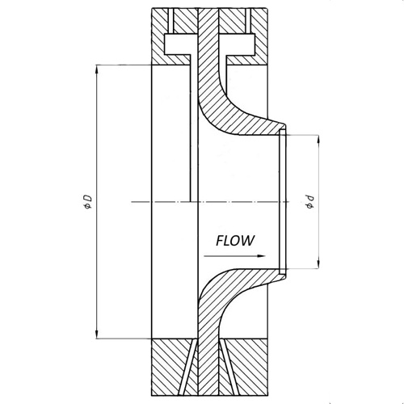
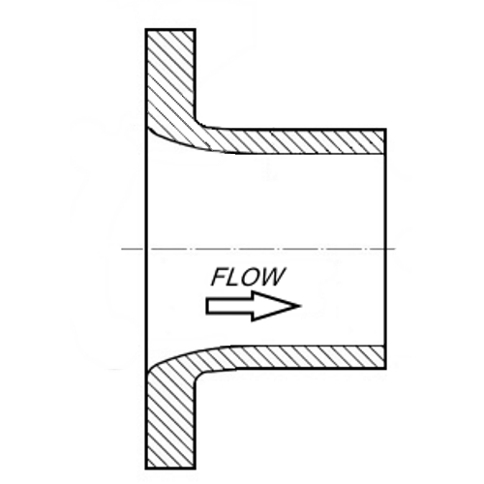
Introduction
Combined Cycle Power Plants
Flow measurement equipment
Venturis
ISA 1932 nozzles
Long radius nozzles
ISO 5167-3,4 (2003)
Small range of Reynolds numbers

Slide 4
Introduction – ISO characteristics
 | ISA 1932 Nozzle | Long radius Nozzle, high β | Venturi Machined
ISO 5167-.. | 3 | 3 | 4
β [-] | 0.44 ~ 0.80 | 0.25 ~ 0.80 | 0.40 ~ 0.75
d [mm] | 50 ~ 500 | 50 ~ 630 | 50 ~ 250
Re_{D} /10⁶ [-] | 0.02 ~ 10 | 0.01 ~ 10 | 0.2 ~ 1
C_{d} [-] | Eq. (3) | Eq. (8) | 0.995
U(C_{d}) [-] | β ≤ 0.6: 0.8% β >0.6: (2β-0.4)% | 2.0% | 1.0%
Re_{D} /10⁶ Orifice 0.005 ~ 100 (∞)

Slide 5
Introduction – Questions
Questions
Scope expansion in Re domain
Improve uncertainty of the standard
Similarity of lab results
→ Intercomparison
Fluid | Labs | t [ ̊C] | p [bara] | Re_{D} [-]
Water | A,B,C.D | 20 / 40 | - | 7.2·10⁵ - 2.5·10⁶
Hot water | H | 80 | - | 2.5·10⁶ - 1.0·10⁷
Natural Gas | E,F,G | 10 - 20 | 45 - 50 | 3.5·10⁶ - 2.4·10⁷

Slide 6
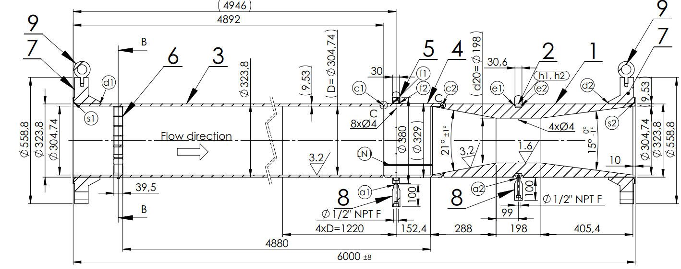
Dp packages
12” stainless steel, length 6 m
Nozzles β = 0.59, Venturi β = 0.64
ASME PTC-6 flow conditioner
Double pressure tappings A and B

Slide 7
Results – 1
‑0.02% ± 0.09%

Slide 8
Results – 2
‑0.04% ± 0.19%

Slide 9
Results – 3
0.03% ± 0.21%

Slide 10
Results – Calibration C_{d} – 1
C_{d} / C_{d,ISO} – 1 = – 0.21% ± 0.17%

Slide 11
Results – Calibration C_{d} – 2
C_{d} / C_{d,ISO} – 1 = 0.09% ± 0.17%

Slide 12
Results – Calibration C_{d} – 3
3%
2%

Slide 13
Discussion – A & B tappings
Difference between A and B tappings
Generally small
Increase at the lower end of the Re range
ISA nozzle smallest differences Venturi greatest differences
Stronger effects at specific labs
Trapped air in water pressure lines excluded
Moisture in gas pressure lines excluded
Other gas in gas pressure lines excluded
No influence on the general picture

Slide 14
Discussion – Literature values
General
All results within the uncertainty of the ISO 5167
No discontinuities between water, hot water and natural gas
Scope extension and uncertainty reduction possible
ISA 1932 nozzle
Systematically below C_{d,ISO}
Results may be approximate by a straight line
Long radius nozzle
Water results close to literature values
Scatter (2s value) identical to ISA
Venturi
Highest scatter

Slide 15
Discussion – Intercomparison
Intercomparison
Agreement if
95% confidence
ISA nozzle and long radius nozzle
All lab results agree with at least 95% confidence
Venturi
Gas results agree with two exceptions
Water at the low Re some significant differences
Inherent instability due to abrupt shape changes: stall
Gaming technology? (Van Weers et al., Flomeko 1998)
Design improvement (Reader-Harris et al., FM&I 2001)

Slide 16
Conclusions – initial questions
Our questions:
Scope extension
Possible for all devices
Curve of water, hot water and natural gas connect very well
Uncertainty reduction
Possible for all devices
More β ratios to be tested
For best uncertainty – calibrate in proper Re range
Intercomparison
Agreement between labs for the nozzles
Venturi: some significant differences
ISA 1932 nozzle best suited for wide Re range

Slide 17
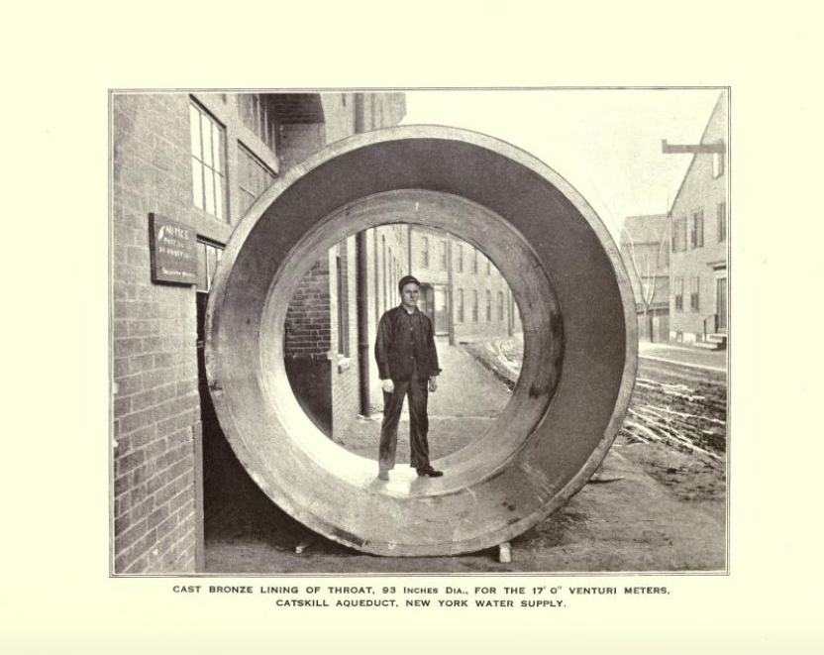
Thank you !
EuroLoop: Calibration is our passion !
?

