Slide 1


SIP-HLT07 contributions to method improvement in syringe pumps calibration
Elsa Batista, Isabel Godinho, Maria do Céu Ferreira, Andreia Furtado – IPQ (Portuguese Institute for Quality), Portugal
Peter Lucas – VSL B.V. Dutch Metrology Institute, Delft, Netherlands

Slide 2
Resume
Introduction
MeDD outcome
SIP-HLT07
Calibration Methods
Uncertainties
ISO Standards
Conclusions

Slide 3
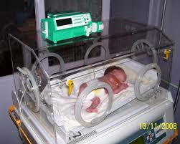
Introduction
  Infusion instruments are widely used and fundamental for primary health care, in/out hospital providing drug delivery, nutrition and hydration to patients.
  It is crucial that the volume and flow measured by these devices be the most accurate and precise possible.
  It is necessary to have the appropriate calibration methods.
  From 2012 to 2015, such calibration methods have been the main focus of the project Metrology for Drug Delivery (MeDD) from the European Metrology Research programme (EMRP).

Slide 4
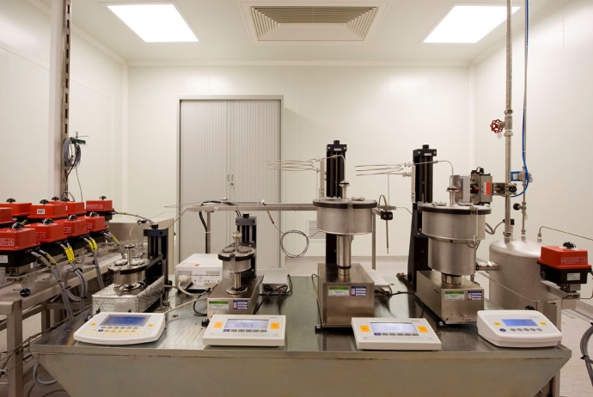
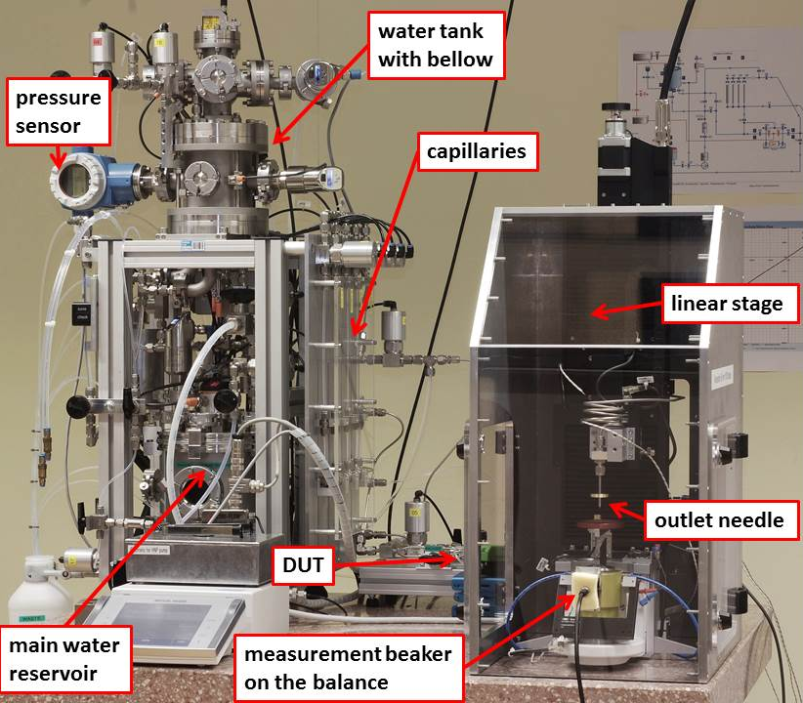
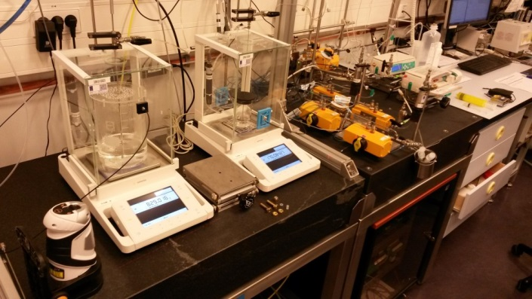
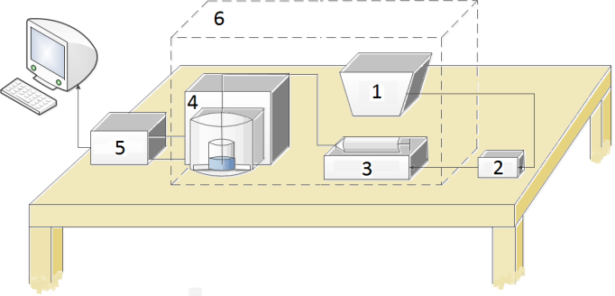
MeDD Outcome
  In MeDD, METAS, DTI, CETIAT, IPQ and VSL developed the primary standards for liquid flow rate ranging from 100 nl/min to 10 ml/min .
  The primary standards for liquid flow rate were validated by means of a EURAMET comparison, project 1291

Slide 5

MeDD Outcome
  Two secondary standards, a flowmeter and a syringe pump were calibrated for flow rates in an interval from 33.3 μl/min to 10 ml/min. The results obtained by the participant laboratories were in agreement with the determined reference value.
  Assays for flow rate, start up delay, compliance, temperature, pressure and viscosity like in were performed to determine the measurement accuracy of several drug delivery devices.
  Special issue of Biomedical Engineering published in 2015, number 60 (4) with all results

Slide 6




EMPIR – 15SIP03- HLT07
The outcomes of MeDD were discussed in international conferences and presented in scientific papers, reports and best practice guides that can be found in www.drugmetrology.com. Nonetheless, this data was never formalized in the way of amendments of the relevant standards, specifically ISO 7886-2 , IEC 60601-2-24 and ISO 28620.
To further communicate the knowledge obtained from MeDD JRP, a new project (Support for Impact Project (SIP) 15SIP03 – Infusion Uptake) started in May of 2016.
This project is in frame with the European Metrology of Innovation and Research Programme (EMPIR).
The participants are IPQ, VSL, UMC-Utrecht, DTI and ESICM

Slide 7
EMPIR – 15SIP03- HLT07
The 15SIP03 JRP has two main goals:
To develop an E-learning module made available on the E-learning platform of the ESICM (European Society for Intensive Care Medicine), with the aim to create awareness and understanding of multi infusion risks and thereby reducing dosing errors, thus decreasing adverse patient incidents and increasing the quality of medical treatment.
To incorporate the best metrology practices relating calibration of infusion devices in ISO standards ISO 7886-2 and IEC 60601-2-24.

Slide 8
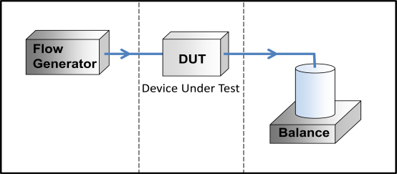
Calibration Method - Gravimetry
The primary method for flow determination in the calibration of syringe pumps is the gravimetric method.
This method is based on the mass measurement of the calibration liquid as a function of time on a balance. The flow rate is in general determined by the quotient of the mass difference (initial and final) and time interval including some corrections
The calibration setup used during MeDD JRP consists of a flow generator, connected to a device under test (DUT) upstream of a collecting vessels standing on an analytical balance . This balance measures the mass, which is precisely timed to calculate the Δm/Δt quotient .

Slide 9
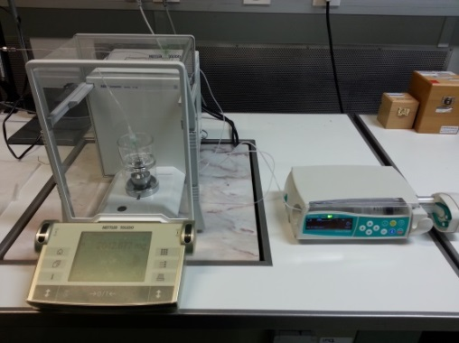
Calibration of syringe pumps
The calibration of syringe pumps is performed at IPQ, by the gravimetric method in a flow interval from 600 ml/h (10 ml/min) to 3 ml/h (50 nl/min) with a 0.15 % to 6 % relative expanded uncertainty.
$$Q=\frac{1}{t_{f}−t_{i}}\left[\left(\left(I_{f}−I_{i}\right)−\left({δm}_{buoy}\right)\right)×\frac{1}{ρ_{wW}−ρ_{A}}×\left(1−\frac{ρ_{A}}{ρ_{B}}\right)×\left[1−γ\left(T−20\right)\right]\right]+δ_{evap}$$

Slide 10
Calibration procedure
Some key points in the calibration of syringe pumps should be consider:
Equilibrate the syringe, the water and all the apparatus at a temperature of approximately 20 ºC for 24 h before testing.
The temperature of the water as well the room temperature, relative humidity and atmospheric pressure are continuously measured and registered throughout the experiment.
Remove the air bubbles and the line is filled by running the syringe pump at a high rate until a steady flow of drops come at the end of the needle. Finally the needle is immersed in the water inside the weighing vessel.
The target flow is programed in the syringe pump. Data acquisition begins after 10 minutes of steady flow over 15 minutes.

Slide 11
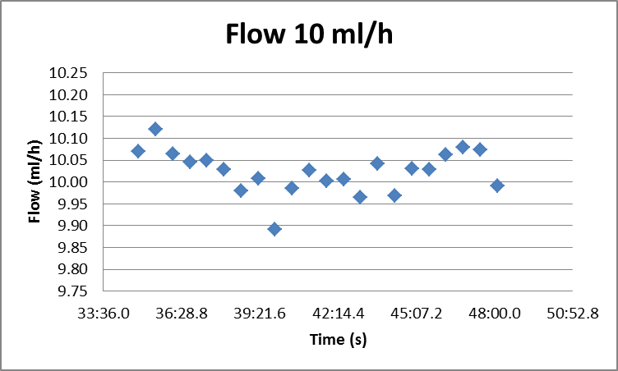
Results
The mean standard variation is of the order of 0.1 %.
The expanded uncertainty is 0.25 %.

Slide 12
Uncertainty calculation
Uncertainty components | Standard uncertainty | Evaluation process | Evaluation type | Distribution
Final mass | u(I_{L}) | Calibration certificate | B | Normal
Initial mass | u(I_{E}) | Calibration certificate | B | Normal
Density of the water | u(r_{W}) | Calibration certificate | B | Normal
Density of the air | u(r_{A}) | Literature | B | Rectangular
Density of the mass pieces | u(r_{B}) | Calibration certificate | B | Rectangular
Temperature | u(T) | Calibration certificate | B | Normal
Expansion coefficient | u(g) | Literature | B | Rectangular
Evaporation | u(δQ_{evap}) | Standard deviation | A | Normal
Final time | u(t_{f}) | Estimation (1 ms) | B | Rectangular
Initial time | u(t_{i}) | Estimation (1 ms) | B | Rectangular
Buoyancy | u(δQ_{mbuoy}) | Calibration certificate | B | Normal
Repeatability | u(δQ_{rep}) | Standard deviation | A | Normal

Slide 13
Improvement on the ISO Standards
Calibration of infusion devices (and accessories) using the gravimetric method:
ISO 7886-2
ISO 28620
IEC 60601-2-24
Need to be improved in the following:
a) There is no addressing on how to correct for evaporation;
b) There is no indication for tests to be performed for different flow rates and replicates;
c) There is no reference for test duration as well as recommendation of minimal time for flow stabilization;
d) The density formula as a function of temperature of the calibration liquid is not given, only the density value at 20 ºC;

Slide 14
Improvement on the ISO Standards
e) There is no correction for buoyancy;
f) No information on how to measure the calibration liquid temperature is given;
g) There is no recommendation for the need to program the syringe pump accordingly to the type of disposable, mainly the plastic syringe used;
h) There is no reference to uncertainty budget.

Slide 15
Conclusions
Currently, several standards dealing with calibration of infusion devices (and accessories) using the gravimetric method, e.g. ISO 7886-2 [5], IEC 60601-2-24 [6] and ISO 28620 [7] exist.
However, for these ISO standards not all buoyancy corrections are taken into account. Consequently, calibrations at low flow rates may be erroneous which can lead to incorrect dosage in medical treatments, i.e. an unexpected over or under doses when used in the field.
We carefully detailed these inconsistencies for each of the ISO standards, where most consistently these fail to provide a clear method on buoyancy correction and detailed parameters of calibration procedure.
We also note a lack of clear instructions for the corrections to which apply on field applications.

Slide 16
Thank you
ebatista@ipq.pt
www.drugmetrology.com
The research leading to the results discussed in this report has received funding from the European Metrology Programme for Innovation and Research (EMPIR). The EMRP is jointly funded by the EMPIR participating countries within EURAMET and the European Union.

